Slide 1
Meeting the Needs of Freshmen and Transfer Students: Using Library Guides and Instruction as Platform
SCLA Conference
Presenters: Susan Moore, MLIS & Janet Ward, MLIS

Slide 2
Learning objectives
Address the information needs of Freshmen and transfer students
Methods for centralizing information
Provide information to aid in student retention and academic achievement

Slide 3
WELCOME!
Let’s get to know each other!

Slide 4
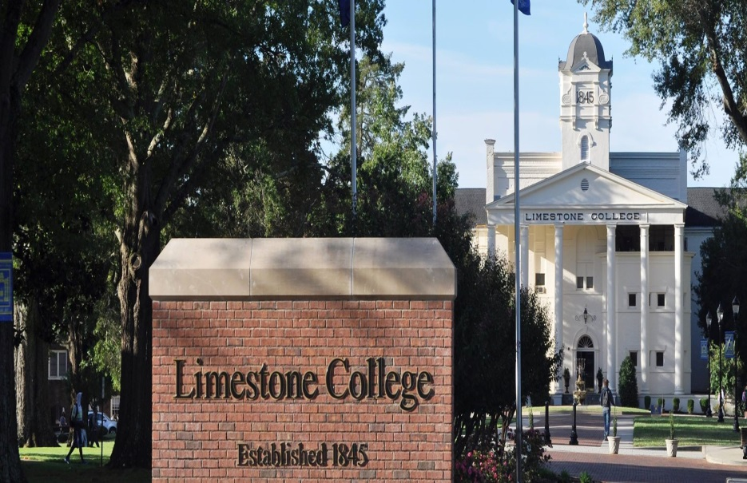
Enrollment
Limestone College enrolls more than 1,000 traditional day students and approximately 2,500 Extended Campus students at eight sites in South Carolina and on the Internet.

Slide 5
Purpose
To provide essential support to students in navigating their way through the first year of college

Slide 6
Description
Student Success @ Limestone College is a digital portal
“Online Success & Survival Kit”
Designed using Springshare LibGuides
Modeled after the student orientation already in place
Input gathered from each department on campus
Includes interactive maps, videos, and live news feeds
Easily updated (no bureaucracy)
Notes:
Student Success @ Limestone College is a digital portal that serves as an “Online Success & Survival Kit” for our students. Designed using libguides, the process was much easier to access and update without bureaucratic delays. We first began modeling the Student Success site after the student orientation already in place. We met with each department on campus – Registrar, Financial Aid, Library staff, Testing Center, Student Services. We asked the departments to list their ideas, links and resources to be added to the Student Success guide. These resources included: suggested page titles, links, scripts, production ideas, text, facts, graphics, and tutorials. We also included interactive maps, videos, and live news feeds, which have been a big hit with our students.

Slide 7
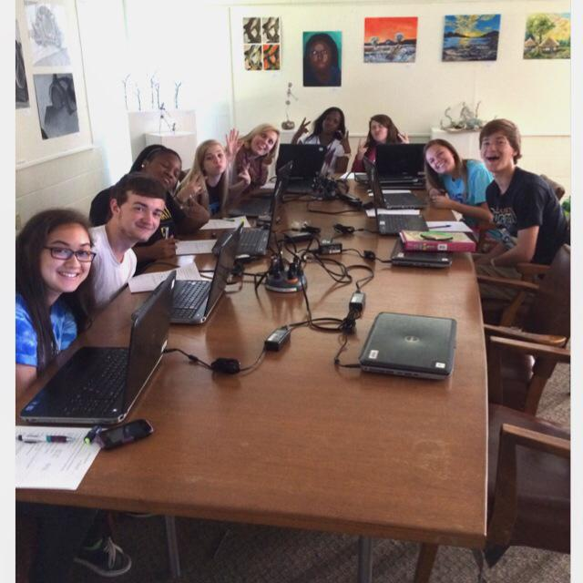
Student Success @ Limestone College LibGuide
The guide was built for Academic Inquiry course over the spring/summer of 2013
Utilized in:
ID 100 Academic Inquiry
ID 110 Study Skills
ID 201 Transition Success

Slide 8
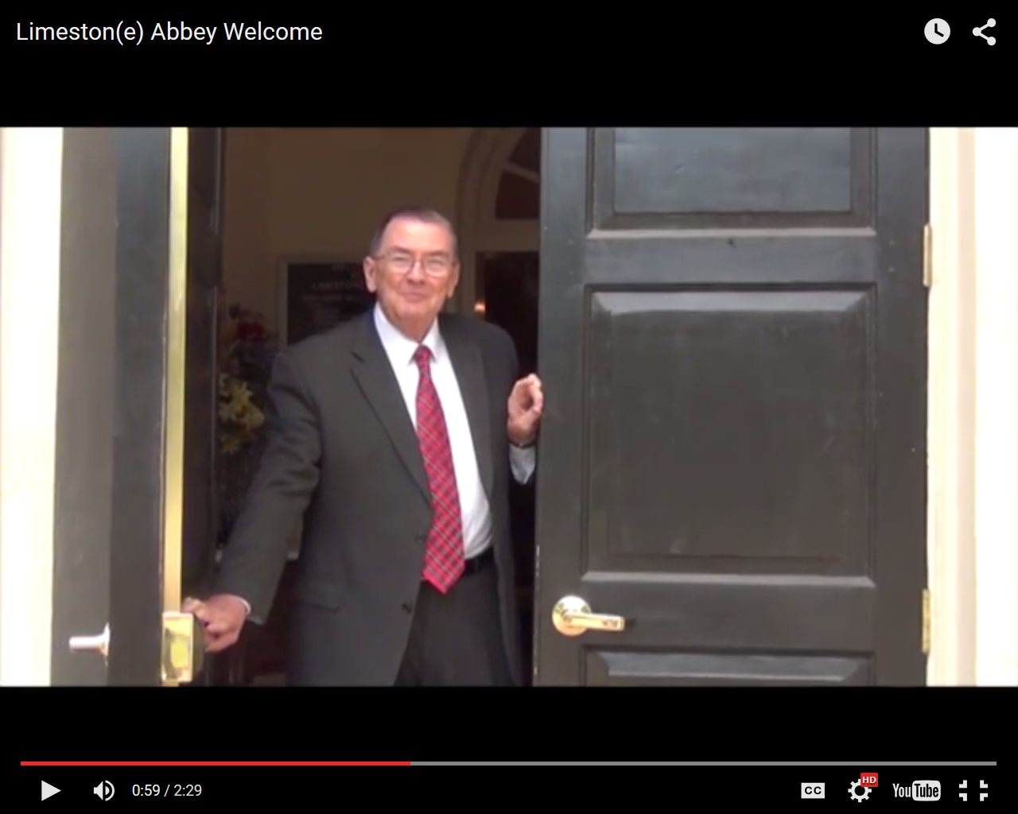
Student Success @ Limestone College
Welcome Students (from the President)

Slide 9
Student Success @ Limestone College
Interactive map using Thinglink

Slide 10
Student Success @ Limestone College
Live news feeds

Slide 11
Student Success @ Limestone College
Mobile ready
View from any device
User friendly interface

Slide 12
Student Success @ Limestone College
Consistent placement of important contact information

Slide 13
Goals
The Student Success guide assists Freshmen with:
Academic goals
Social interactions
Life skills
Career preparation

Slide 14
Student Success @ Limestone College
Before development, students struggled in many areas
Technology
Campus orientation
Expectations (academic & social)

Slide 15
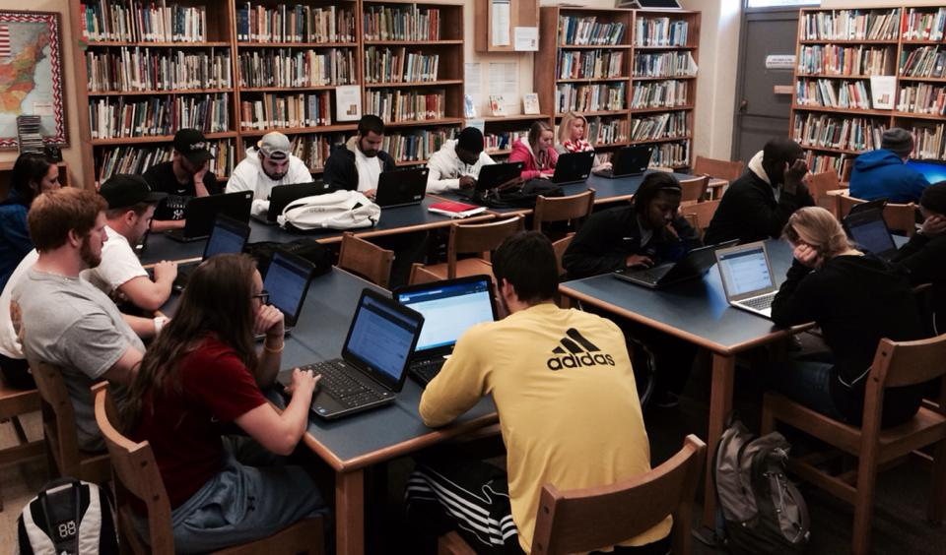
Building on Success
The guide was incorporated into the Transition Success course in Summer 2015
Transition Success is taught to all transfer students (Day, ECC and ECI)
Slightly modified to meet the needs of off-campus and Internet students

Slide 16
Integrated Library Instruction
As an added bonus, the Student Success Guide contains a built in library orientation section
This creates an opportunity for librarians to deliver a one-shot library orientation to ALL freshmen in their first semester on campus
Transfer students receive a slightly different library instruction session based on the research assignment
Essentially all freshmen and transfer students receive library instruction in their first semester

Slide 17
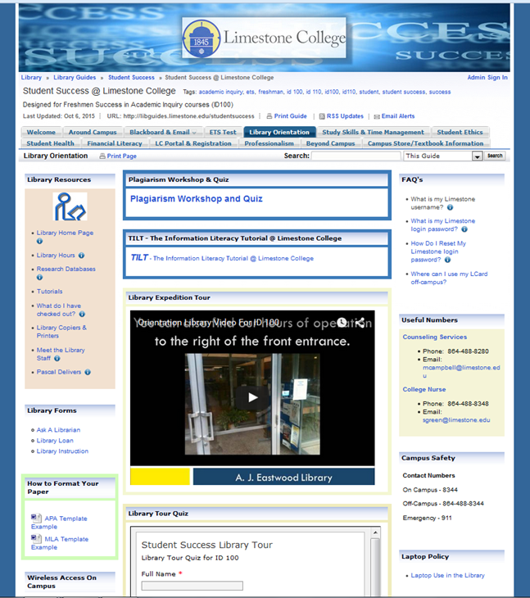
Student Success @ Limestone College
Library Orientation Section

Slide 18
Statistics
During the 2014-2015 academic year:
Student Success LibGuide was viewed 10,853 times
Student Success was the second most viewed guide
Transition Success was sixth in views (5,101 before revision)

Slide 19
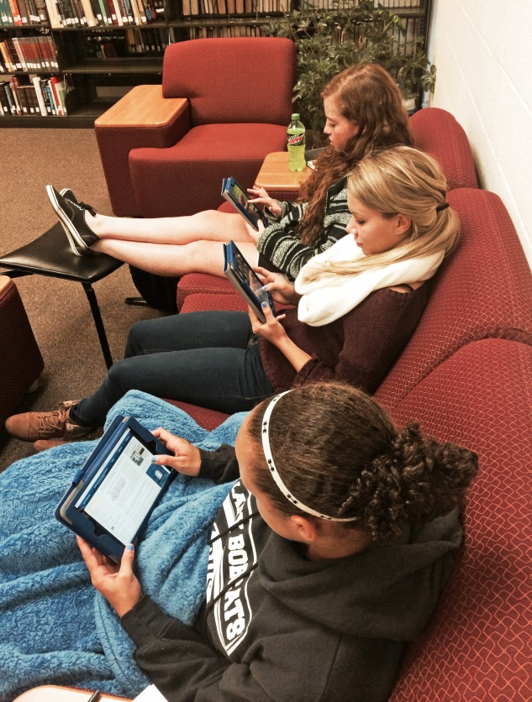
Statistics
In the most recent 4 month period (July 1 – Oct. 19, 2015)
Student Success LibGuide was viewed 7,148 times (#3 in total views)
Transition Success (revised guide) was viewed 16,308 times (#1 in total views)

Slide 20
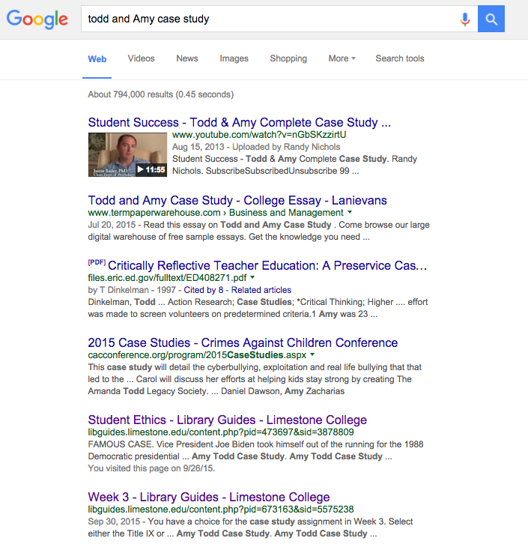
Title IX Case Study
One of the most popular assignments
A Google search for Todd & Amy Case Study shows the Student Success Library Guide as #1, 5 and 7 in the result list.

Slide 21
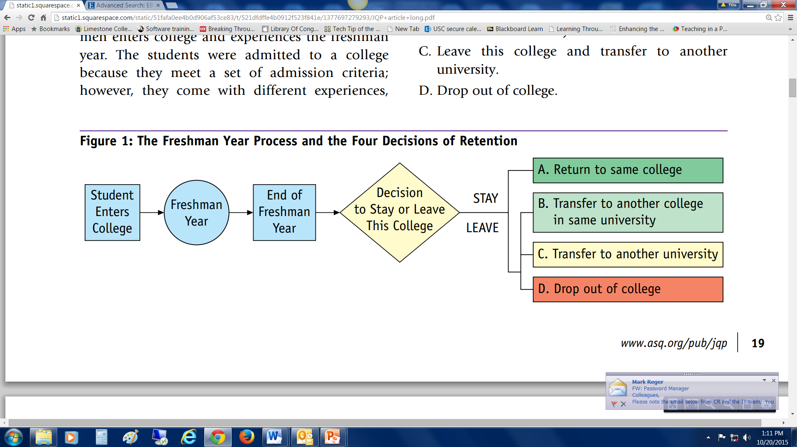
Summary
According to A Strategy for Improving Freshman College Retention by CP Veenstra:
“At the end of the freshmen year, students make a retention decision.”
Return to the same college.
Leave this college and transfer to another college in the same university.
Leave this college and transfer to another university.
Drop out of college.

Slide 22
Summary
If you want your students to be successful, your institution needs to be asking these questions:
Do our students know what resources are available on campus and how to locate them?
What opportunities exist to engage students in educationally purposeful activities both in and out of the classroom?

Slide 23
Works Cited
Veenstra, CP. A Strategy for Improving Freshman College Retention. Journal for Quality and Participation. 2009.
http://static1.squarespace.com/static/51fafa0ee4b0d906af53ce83/t/521dfdffe4b0912f523f841e/1377697279293/JQP+article+long.pdf

Slide 24
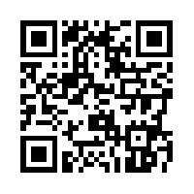
Contact Information
Susan Moore, Instruction Librarian/Archivist
smoore@limestone.edu
Janet Ward, Assistant Director/Web Services
jward@limestone.edu

